Slide 1
Comp Photography
Fall 2015
Final Project
Joel Henry
jhenry38@gatech.edu
Computational Photography @ GT
https://cs6475.wordpress.com/2015-fall/

Slide 2
Android Photo Filter
For my final project, I decided to write an Andriod app that allows the user to apply a variety of image manipulations that were learned in this class and some additional ones.
I intended for this project to strengthen my understanding of the material that I learned over the course, explore additional computational photography methods, utilize OpenCV in java, and gain more experience with the Android platform.
This presentation is available in the original PPTX format from the following link:
https://drive.google.com/file/d/0BxFo95E8M-bWZXNacWowNnhZbDQ/view?usp=sharing
This original format is required for viewing the animated GIFs. Please view in Google Slides or Microsoft PowerPoint.
Computational Photography @ GT

Slide 3
The Goal of This Project
In addtion to this course I am taking CS 6300: Software Development. This course utilizes Java and Android app development. I wanted to both implement what I learned in CS 6475 and CS 6300 into a single application that would certainly push my understanding of each. I created a list of “methods” that I thought I could tackle within the 2 week development period.
Methods to implement:
General management of images on the Android platform
“Black and White” conversion with dynamic threshold
Conversion to “Greyscale”
Apply “Gaussian Blur” with dynamic ksize
Apply “Median” filter with dynamic size
Apply Edge detection with dynamically set low and high threshold
Manipulate individual RGB channels of an image
Computational Photography @ GT

Slide 4
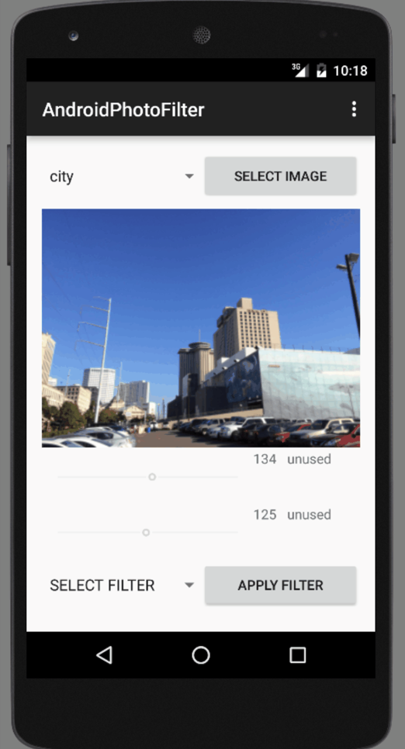
Final Product Description
A snapshot of the app is shown on the right. To describe the final product I created a series of animated GIFs that show the individual capabilities available in the app.
I developed the app using Android Studio V1.3.1 on the Android SDK V23 (Marshmallow). The emulator used to develop the app is the Nexus 5 API 23 x86.
The App is laid out in the following way:
The image is selected via a pull down menu and loaded by hitting the “SELECT IMAGE” button.
When the image is selected, it is loaded on the screen
Under the image, there are two seekbars that can be used to dynamically manipulate values related to the chosen filter. Some filters use both seekbars, only one, or none. The value related to the seekbar is displayed on the screen.
The value that the seekbar is modifying is also displayed on the screen for the user.
When a seekbar is not utilized for the chosen filter, it is deactivated and the label is changed to “unused”
The filter is chosen via a pull down menu on the bottom of the screen and applied by hitting the “APPLY FILTER” button.
Note: the values on the seekbar are applied dynamically so that you can see the effect of the value on the image as the
*Note: To view the animated GIFs, you must view this PowerPoint project at Full Screen (hit F5 on Windows). Here is a link to the Google Drive version of this presentation that has the animated GIFs available without presentation mode.

Slide 5
App Process Flow
Select Image
Display Original Image on screen
Select Filter
Apply Filter
Manipulate value(s)
Display manipulated Image on screen
Computational Photography @ GT

Slide 6
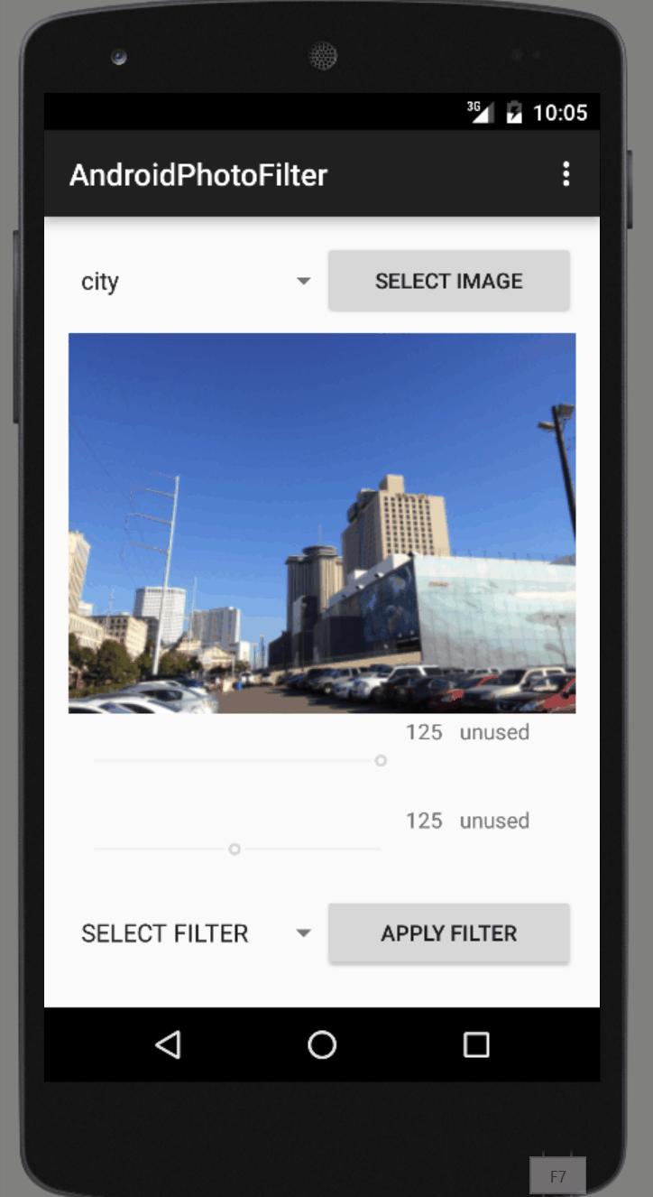
Choosing an Image
I spent a good bit of time understanding how an Android application can store and access images. This is not as trivial as I initially expected. To get this to work, I preloaded 3 PNG images on the app that can be individually selected for manipulation within the app.
The animated GIF to the right shows the process of selecting each of the 3 preloaded images.

Slide 7

Greyscale
The first filter that I chose to implement is converting the image to “greyscale”. This is the most trivial manipulation but once it was successfully implemented, I was able to prove that my process for loading an image, manipulating the image, and displaying the image are working.
A demonstration of this method is shown on the animated GIF on the right.
If viewing this presentation in Microsoft PowerPoint, use the slideshow view (F5).
Mat m = Utils.loadResource(MainActivity.this, drawableInt, Imgcodecs.CV_LOAD_IMAGE_GRAYSCALE); Bitmap bm = Bitmap.createBitmap(m.cols(), m.rows(), Bitmap.Config.ARGB_8888); Utils.matToBitmap(m, bm); image.setImageBitmap(bm);

Slide 8
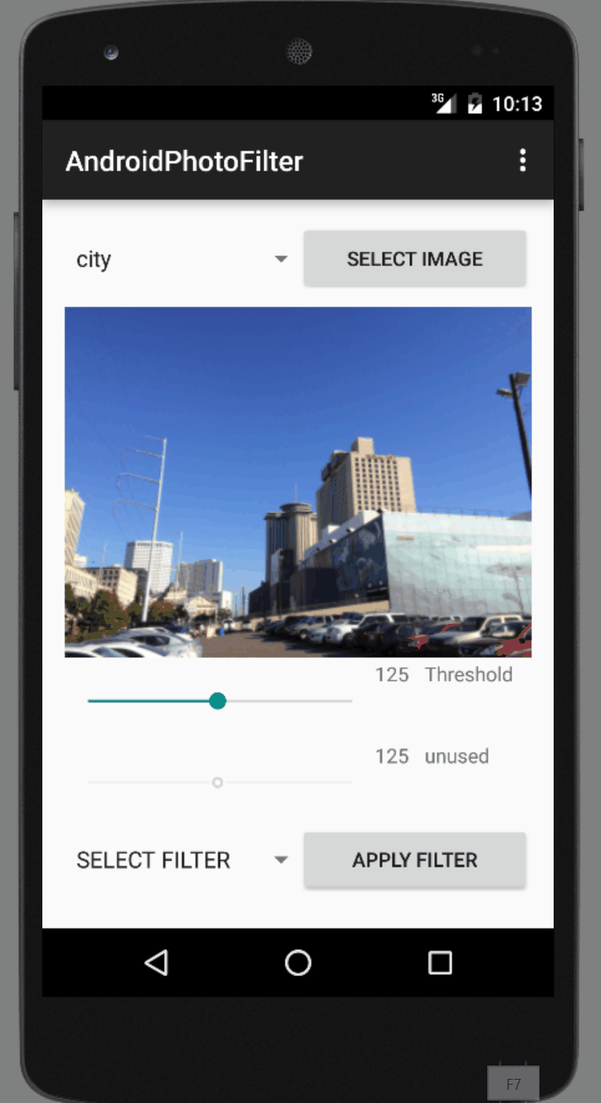
Black and White
The next filter that is implemented is the “Black and White” filter. The black and white conversion utilizes a threshold value that is used to determine how each pixel is converted. When the “Black and White” filter is selected, the top seekbar is activated and the user can dynamically modify the value of the Threshold. Being able to modify the threshold value and immediately see the effects is a great way to determine the best threshold value for the selected image.
A demonstration of this method is shown on the animated GIF on the right.
If viewing this presentation in Microsoft PowerPoint, use the slideshow view (F5).
Mat m = Utils.loadResource(MainActivity.this, drawableInt, Imgcodecs.CV_LOAD_IMAGE_GRAYSCALE); Imgproc.threshold(m, m, seekValue, 255, Imgproc.THRESH_BINARY); Bitmap bm = Bitmap.createBitmap(m.cols(), m.rows(), Bitmap.Config.ARGB_8888); Utils.matToBitmap(m, bm); image.setImageBitmap(bm);

Slide 9
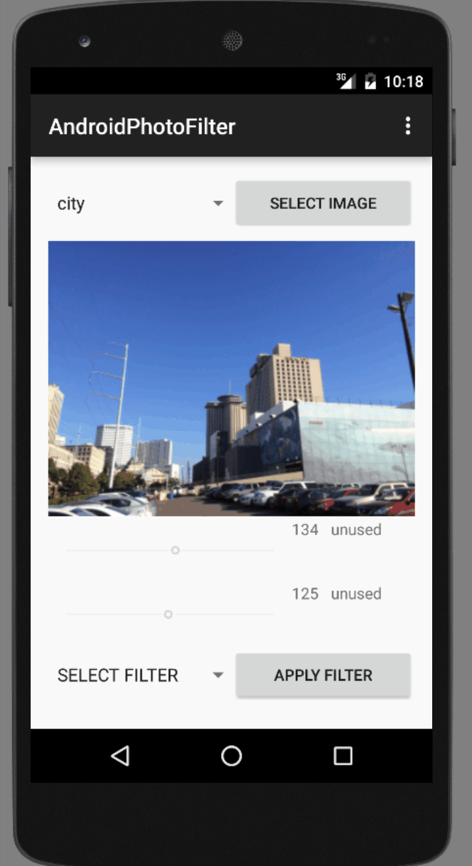
Gaussian Blur
The next filter that is implemented is the “Gaussian Blur” filter. This filter utilizes a value for the size of the kernel used to blur the image. When the “Gaussian Blur” filter is selected, the top seekbar is activated and the user can dynamically modify the value of the kernel size. This dynamic manipulation is useful in learning how the kernel size affects the result.
A demonstration of this method is shown on the animated GIF on the right.
If viewing this presentation in Microsoft PowerPoint, use the slideshow view (F5).
Mat m = Utils.loadResource(MainActivity.this, drawableInt, Imgcodecs.CV_LOAD_IMAGE_COLOR); Imgproc.GaussianBlur(m, m, new Size(seekValue, seekValue), 0); Imgproc.cvtColor(m, m, Imgproc.COLOR_BGR2RGB); Bitmap bm = Bitmap.createBitmap(m.cols(), m.rows(), Bitmap.Config.ARGB_8888); Utils.matToBitmap(m, bm); image.setImageBitmap(bm);

Slide 10

Median
The next filter that is implemented is the “Median” filter. This filter is very similar to the Gaussian Blur filter and utilizes a value for the size of the kernel used to manipulate the image. When the “Median” filter is selected, the top seekbar is activated and the user can dynamically modify the value of the size.
A demonstration of this method is shown on the animated GIF on the right.
If viewing this presentation in Microsoft PowerPoint, use the slideshow view (F5).
Mat m = Utils.loadResource(MainActivity.this, drawableInt, Imgcodecs.CV_LOAD_IMAGE_COLOR); Imgproc.medianBlur(m, m, seekValue); Imgproc.cvtColor(m, m, Imgproc.COLOR_BGR2RGB); Bitmap bm = Bitmap.createBitmap(m.cols(), m.rows(), Bitmap.Config.ARGB_8888); Utils.matToBitmap(m, bm); image.setImageBitmap(bm);

Slide 11

Edge
The next filter that is implemented is the “Edge” filter that displays the edges detected in an image. This filter utilizes two values: one for the upper threshold and one for the lower threshold. When the “Edge” filter is selected, both seekbars are activated and the user can dynamically modify the value of the upper and lower threshold. This is the most interesting filter in my opinion since it really helps to understand how the edge detection algorithm works.
A demonstration of this method is shown on the animated GIF on the right.
If viewing this presentation in Microsoft PowerPoint, use the slideshow view (F5).
Mat m = Utils.loadResource(MainActivity.this, drawableInt, Imgcodecs.CV_LOAD_IMAGE_GRAYSCALE); Imgproc.Canny(m, m, seekValue, seekValue2, 3, false); Bitmap bm = Bitmap.createBitmap(m.cols(), m.rows(), Bitmap.Config.ARGB_8888); Utils.matToBitmap(m, bm); image.setImageBitmap(bm);

Slide 12
RGB Filters
The next three filters, I experiment with manipulating individual channels of a color image. The user can modify the Red, Green or Blue value of an image. In this case the slider range (0-255) is converted into a percentage and multiplied by the value stored in the selected channel at each pixel in the image. This was the most challenging method to implement since I had not worked with multiple channels in depth.
A demonstration of all three of these are shown on the next slide.
If viewing this presentation in Microsoft PowerPoint, use the slideshow view (F5).
Mat m = Utils.loadResource(MainActivity.this, drawableInt, Imgcodecs.CV_LOAD_IMAGE_COLOR); List<Mat> lRgb = new ArrayList<Mat>(3); int rows = m.rows(); int cols = m.cols(); int ch = m.channels(); for (int i=0; i<rows; i++) { for (int j=0; j<cols; j++) { double[] data = m.get(i, j); double seekValueDouble = (double)seekValue; data[2] = (seekValueDouble/255)*data[2]; m.put(i, j, data); } } Imgproc.cvtColor(m, m, Imgproc.COLOR_BGR2RGB); Bitmap bm = Bitmap.createBitmap(m.cols(), m.rows(), Bitmap.Config.ARGB_8888); Utils.matToBitmap(m, bm); image.setImageBitmap(bm);

Slide 13




Slide 14
Project Source
The animated GIFs embedded in this presentation give you a great way to see the app in use.
Additionally, my app is publically available via GitHub at the following link:
https://github.com/joelrh/6475Fall2015jhenry38
I encourage you to download and try it out if you have access to Android Studio.
Computational Photography @ GT

Slide 15
What worked
I was able to implement my initially planned methods in the Android app. I’m surprised how well the dynamic manipulation of filter values worked.
The dynamic image manipulation is a great way to help understand how various values affect the output.
The Android app is easy to use and responsive.
Computational Photography @ GT

Slide 16
What did not work? Why?
I spent about half of the development time learning how to load and process images within java and Android. This is not as trivial task as I originally thought. Getting the openCV tools to properly load and work on an Android app is relatively difficult and took a substantial amount of trial and error. Although openCV has been available for the Android platform for some time, it is not as “plug-and-play” as most add-ons.
I struggled with the limited CPU and memory available on a mobile phone. To get the desired real-time value manuplation, I had to scale the images down to around 300x300. The original images causes slow manipulation and memory errors due to the emulator’s limited computing power.
Although I was able to implement my planned filters, I hoped to include a few more that were further beyond the scope of the course.
Computational Photography @ GT

Slide 17
Additional Details
I found this project to be quite a challenge based on my limited work with openCV and Android. I have certainly strengthened my understanding of each. This has really opened the door for me to further explore the capabilities of openCV and Andriod.
I plan to test the ability to track images in real-time using and Android phone.
Computational Photography @ GT

Slide 18
References / Pointers
This app heavily relies on the methods available in the OpenCV library:
http://opencv.org/
I utilized Stack Overflow to resolve many issues ranging from bug fixes to image handling:
http://stackoverflow.com/
The following websites were good sources on learning to work with images in Android and Java:
http://www.mkyong.com/android/android-imageview-example/
http://www.developer.com/ws/android/programming/Working-with-Images-in-Googles-Android-3748281-2.htm
Computational Photography @ GT

